Slide 1

Object Recognition using Classical Machine Learning (Track 1)
Exploring Feature Engineering with HOG + SVM/KNN on CIFAR-10

Slide 2
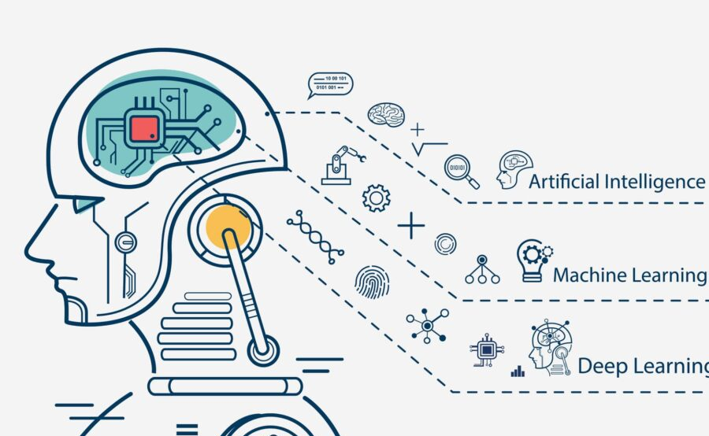
Contents
Introduction
EDA
Pre-Processing
Data partitioning
Architecture
Training
Evaluation
Strengths & Weaknesses
Comparative Insights
Code
Conclusion
References

Slide 3
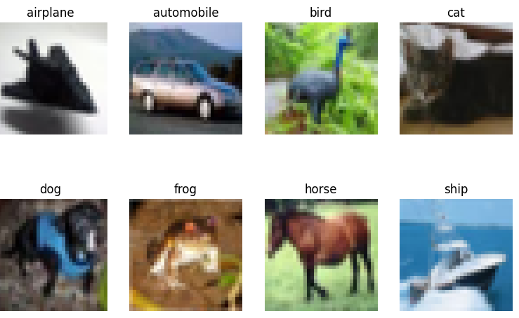
Introduction
Object recognition plays a vital role in many modern AI systems, such as autonomous driving, security monitoring, and biometric identification.
The CIFAR-10 dataset serves as a standard benchmark for image classification research, containing 60,000 color images of 32×32 pixels divided into 10 distinct categories (Krizhevsky et al., 2009).
In this work, we apply a traditional machine learning framework that combines Histogram of Oriented Gradients (HOG) feature extraction with Support Vector Machine (SVM) and K-Nearest Neighbor (KNN) classifiers.
The goal is to evaluate how effectively classical ML models can perform visual object recognition tasks using hand-crafted features instead of deep learning methods.

Slide 4
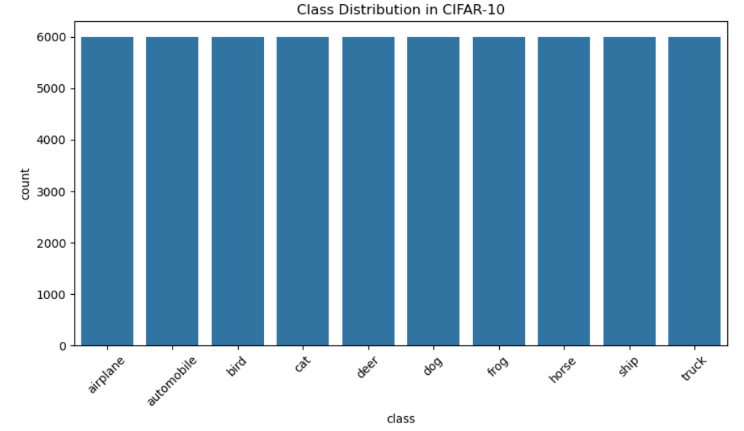
Exploratory Data Analysis (EDA)
CIFAR-10 has balanced classes (6,000 images per class).
Images are 32x32 RGB.
Visualization: Diverse objects, high intra-class variance.
Challenge: Low resolution, complex patterns—unsuitable for raw ML input without feature engineering.

Slide 5
Pre-Processing
Images were normalized by scaling pixel values to the range [0, 1].
Feature Extraction:
RGB images were converted to grayscale to simplify computation.
Histogram of Oriented Gradients (HOG) was then applied to extract shape and edge-based features.
HOG effectively captures texture and orientation information, which is essential for enabling classical models such as SVM and KNN to accurately differentiate between object classes (Dalal & Triggs, 2005).

Slide 6
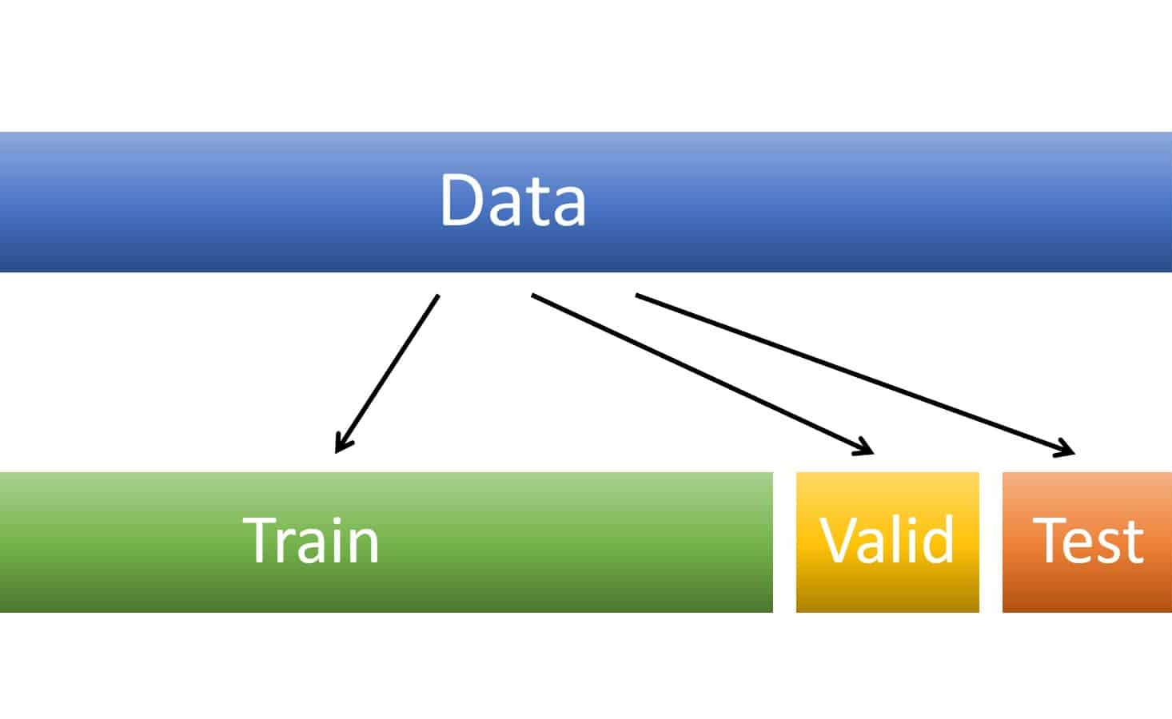
Data Partitioning
Combined CIFAR-10 train & test sets (60,000 images).
Split:
60% Training (36,000)
20% Validation (12,000)
20% Test (12,000)
Stratified sampling was used to preserve class balance throughout all dataset partitions.

Slide 7
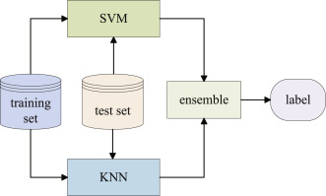
Model Architecture (Classical ML)
Support Vector Machine (SVM):
Linear kernel
C = 1 (regularization)
K-Nearest Neighbors (KNN):
k = 5
Both models were trained using HOG features, consisting of approximately 5,000 dimensions per image.

Slide 8
Training Strategy
Feature extraction using HOG took a few minutes for the entire set of 60,000 images.
SVM and KNN models were trained on 36,000 samples.
Since these are classical models, there is no epoch or batch structure—the models are trained only once.
A validation set was used for model comparison prior to final testing.
Unlike deep learning approaches, classical models do not involve iterative training or loss curves (Rawat & Wang, 2017). Instead, both models were trained once on precomputed HOG features using the scikit-learn framework (Pedregosa et al., 2011).

Slide 9
Evaluation – SVM (Validation)
Accuracy: 52.15%
Stronger on structured classes (e.g., trucks, cars).
Confusion Matrix: Shows confusion among animals (dog, cat, deer).
Macro F1: ~0.52 → fair generalization

Slide 10
Evaluation – KNN (Validation)
Accuracy: 46.79%
Higher recall for simple shapes (e.g., class 1, class 6).
Struggled with high-dimensional HOG space.
Confusion Matrix: Heavy confusion for animal classes.

Slide 11
Test Set Evaluation
SVM:
Accuracy: 52.39%
Consistent with validation
Best for: Airplane, Truck
KNN:
Accuracy: 47.05%
Recall bias towards simple structured classes
HOG + Linear SVM > HOG + KNN on both sets.

Slide 12
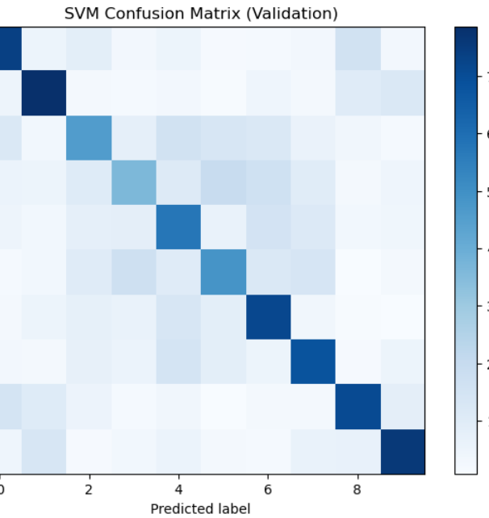
Confusion Matrix - SVM
The SVM confusion matrix indicates an overall test accuracy of 52.4%. The model performs well on digits such as 0, 1, and 9, which show the highest rates of correct classification. However, it struggles with digits like 2, 3, 4, and 5, where frequent misclassifications occur due to overlapping visual features. For instance, class 3 is often mistaken for classes 4, 5, and 6. These results suggest that while the model effectively recognizes certain digits, it faces challenges in distinguishing visually similar classes, highlighting the need for improved feature representations or more advanced modeling techniques.

Slide 13
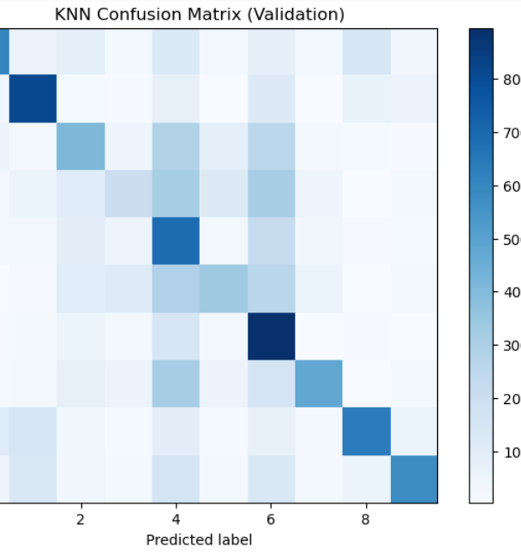
Confusion Matrix - KNN
The K-Nearest Neighbors (KNN) model achieved an overall accuracy of 47%, correctly classifying just under half of the 12,000 test digits. Its strongest performance was observed for digit 1 (67% recall), digit 6 (74%), and digit 4 (57%). However, these results are counterbalanced by significant confusion across other classes.
Digit 3 is often misclassified as 4 or 6, with only 207 out of 1,200 samples correctly identified.
Digit 5 is heavily split between classes 4 and 6, resulting in a recall of just 29%.
Digit 2 is frequently confused with 4, 5, and 6, while digits 8 and 9 are commonly mistaken for 0 and 1.
Overall, the confusion matrix reveals that KNN performs well on certain digits but struggles with those that share overlapping pixel structures, leading to broad off-diagonal error bands. Improving feature extraction or employing a more discriminative model could enhance overall accuracy.

Slide 14
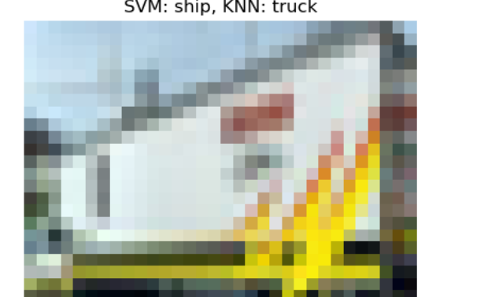
Single Image Test

Slide 15
Strengths & Weaknesses
Strengths
Simple & Interpretable: Easy to implement and analyze.
No need for large GPU resources: Efficient on CPU.
Effective with limited data: Performs adequately even with smaller datasets.
HOG captures shape/orientation features: Effective for capturing structured patterns such as edges and contours (Dalal & Triggs, 2005).
Weaknesses
Lower accuracy on complex datasets like CIFAR-10: Can't capture high-level abstract features (e.g., textures, context).
No end-to-end learning: Feature extraction (HOG) is fixed, not optimized with classification.
Scalability issues:
SVMs are slow on large datasets.
KNN is memory-heavy and slow during prediction.
No training curves: Harder to monitor learning progress (unlike deep learning models).

Slide 16
Comparative Insights
Metric | SVM | KNN
Accuracy | 52.4% | 47.0%
Precision | Moderate | Lower
Confusion | Balanced | More class confusion
Train Speed | Slower | Faster
Trade-Offs:
SVM generalizes better in high-dimensional HOG space.
KNN suffers due to curse of dimensionality.

Slide 17
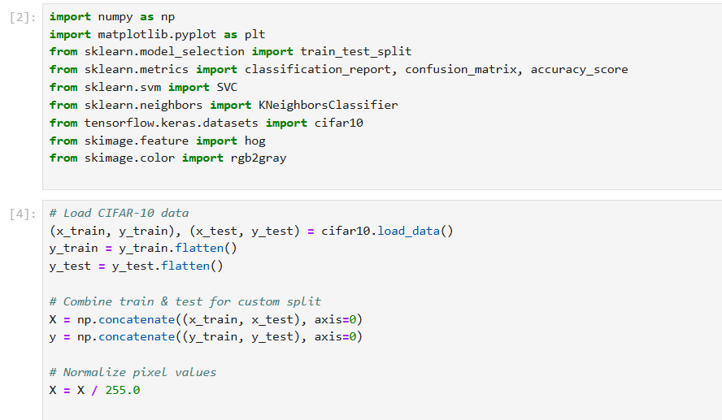
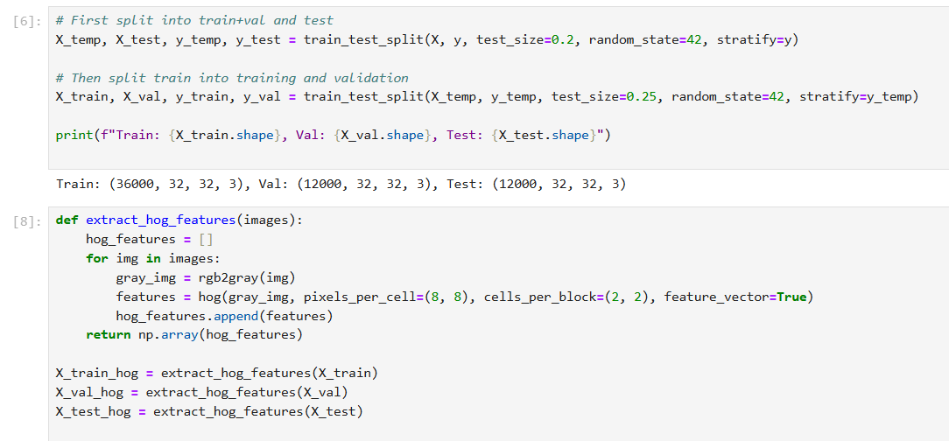
Code

Slide 18
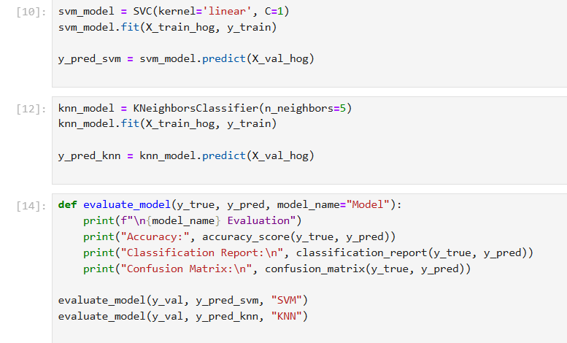
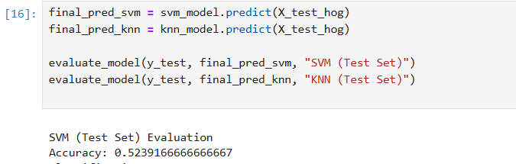

Slide 19
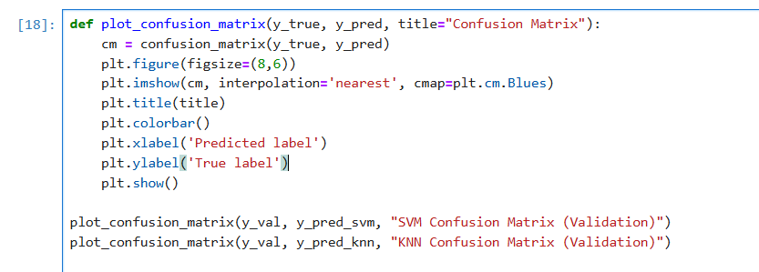

Slide 20
Conclusion
Classical machine learning remains viable when supported by effective feature engineering.
The combination of HOG and SVM delivers modest performance on the CIFAR-10 dataset.
Animal classes present greater challenges due to their complex textures.
Deep learning models are likely to outperform classical approaches because of their ability to automatically learn hierarchical feature representations.

Slide 21
References
Cortes, C., & Vapnik, V. (1995). Support-vector networks. Machine Learning, 20(3), 273–297. Available at: https://doi.org/10.1007/BF00994018 (Accessed: 12 Oct 2025).
Cover, T., & Hart, P. (1967). Nearest neighbor pattern classification. IEEE Transactions on Information Theory, 13(1), 21–27. Available at: https://doi.org/10.1109/TIT.1967.1053964 (Accessed: 12 Oct 2025).
Dalal, N., & Triggs, B. (2005). Histograms of Oriented Gradients for Human Detection. In Proceedings of the IEEE Computer Society Conference on Computer Vision and Pattern Recognition (CVPR), 886–893. Available at: https://doi.org/10.1109/CVPR.2005.177 (Accessed: 12 Oct 2025).
Krizhevsky, A. (2009). Learning Multiple Layers of Features from Tiny Images. Technical Report, University of Toronto. Available at: https://www.cs.toronto.edu/~kriz/cifar.html (Accessed: 12 Oct 2025).
Pedregosa, F., et al. (2011). Scikit-learn: Machine Learning in Python. Journal of Machine Learning Research, 12, 2825–2830. Available at: https://www.jmlr.org/papers/v12/pedregosa11a.html (Accessed: 13 Oct 2025).
Rawat, W., & Wang, Z. (2017). Deep Convolutional Neural Networks for Image Classification: A Comprehensive Review. Neural Computation, 29(9), 2352–2449. Available at: https://doi.org/10.1162/neco_a_00990 (Accessed: 13 Oct 2025).

